Slide 1
Differential Gene Expression Analysis
Bobby Sims EE282 F24 Final Project

Slide 2
Background
Dataset from Pohar et al study investigating therapeutic potential of adoptive transfer of engineered anti-inflammatory T regulatory cells for treatment of auto immune inflammatory conditions in murine Encephalitis model
For non engineered T-cells: Baseline measure of endogenous differential gene expression between conventional and regulatory CD4+ T-cells in health and in response to induced inflammation of the central nervous system
GEO Omnibus ID: GSE 164460

Slide 3
Groups
Treg naïve spleen n=3 | Tconv naïve spleen n=3
Treg EAE spleen n=3 | Tconv EAE spleen n=3
Treg EAE CNS n=3 | Tconv CNS n=4
GEO Omnibus ID: GSE 164460
Conventional T cells (Tconv)
Regulatory T-cells (Treg)
Normal (Naïve)
Disease (EAE)
Microarray Data
20 Samples 6 phenotypes
45101 Genes Observed

Slide 4
Comparisons Rationale
Treg vs Tconv Naïve (spleen) baseline homeostatic expression profiles of both (Control)
Treg vs Tconv EAE (spleen) expression profiles of both at disease peak compared to each other
Treg Naive vs Treg EAE and Tconv Naïve vs Tconv EAE
Treg vs Tconv EAE (CNS)
Compare gene expression among Tregs and Tconv in health and inflammatory state
Compare expression profiles of Tregs between physiological niches i.e. (EAE in CNS vs Spleen) at disease peak

Slide 5
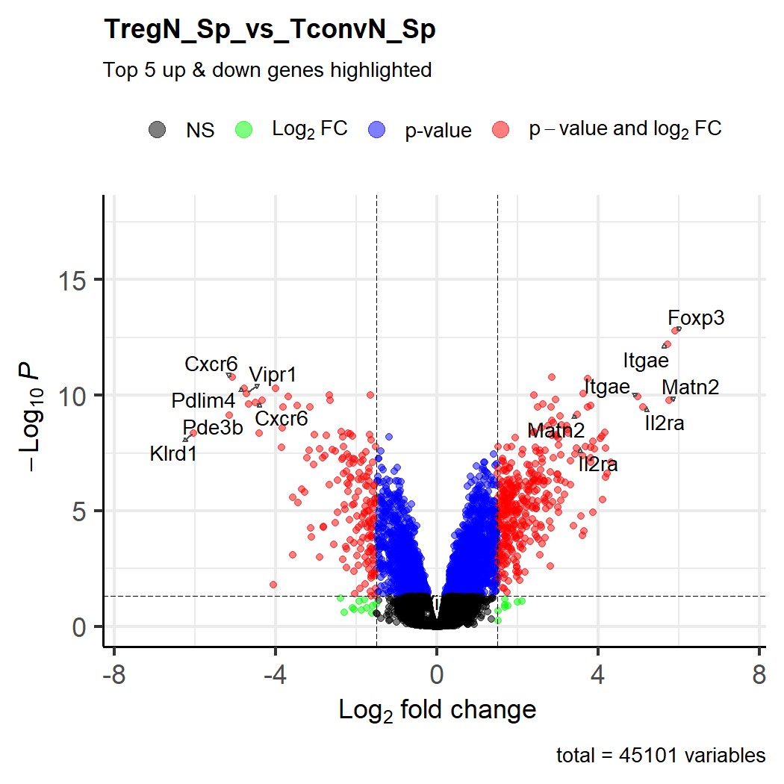
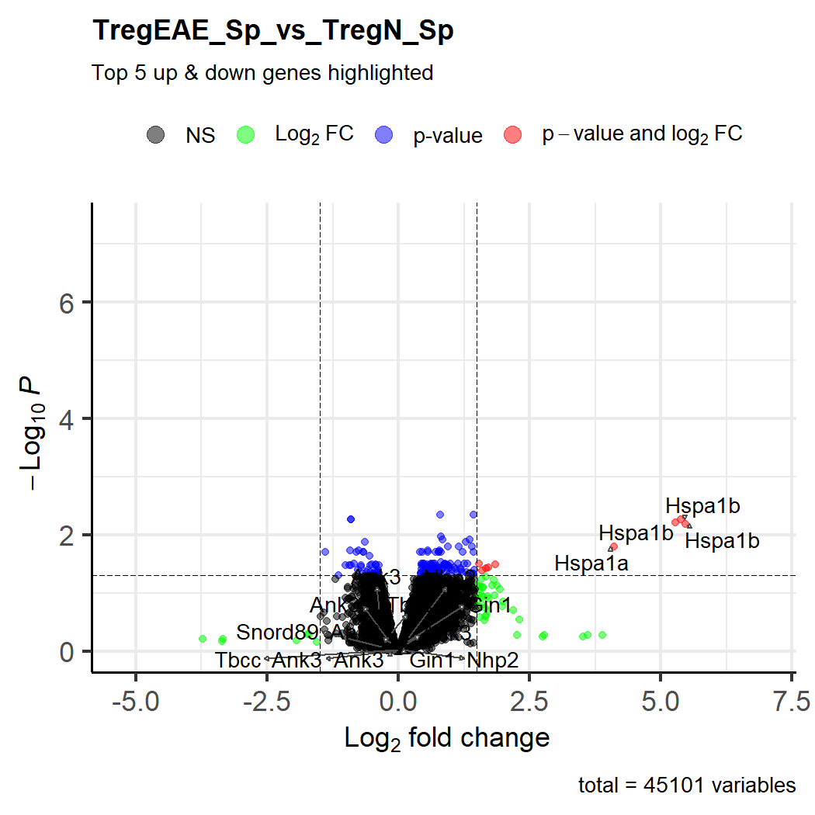
Notes:
Top 5 Up and downregulated genes filtered by Log2 fold change and adjusted p-value

Slide 6
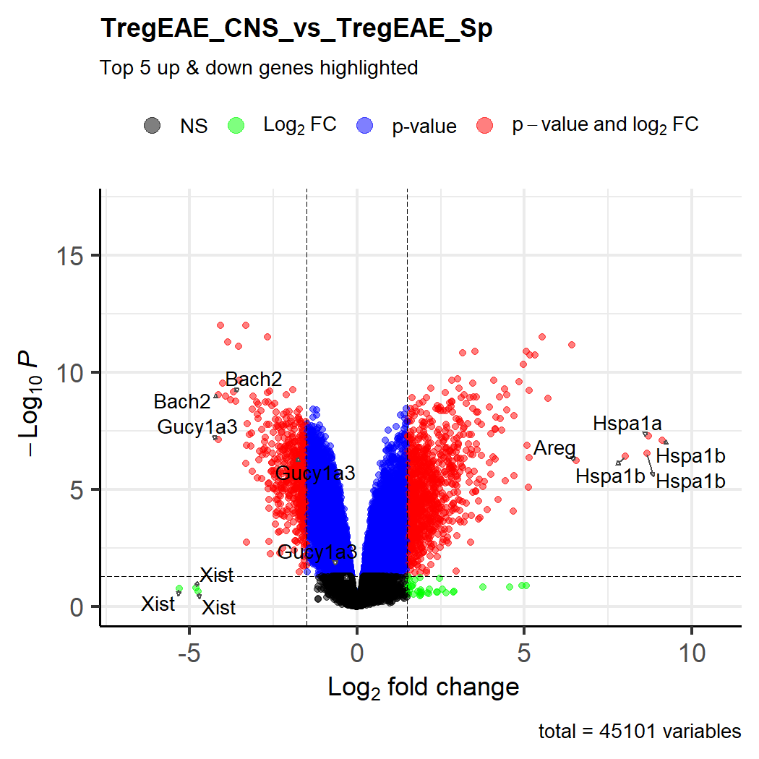
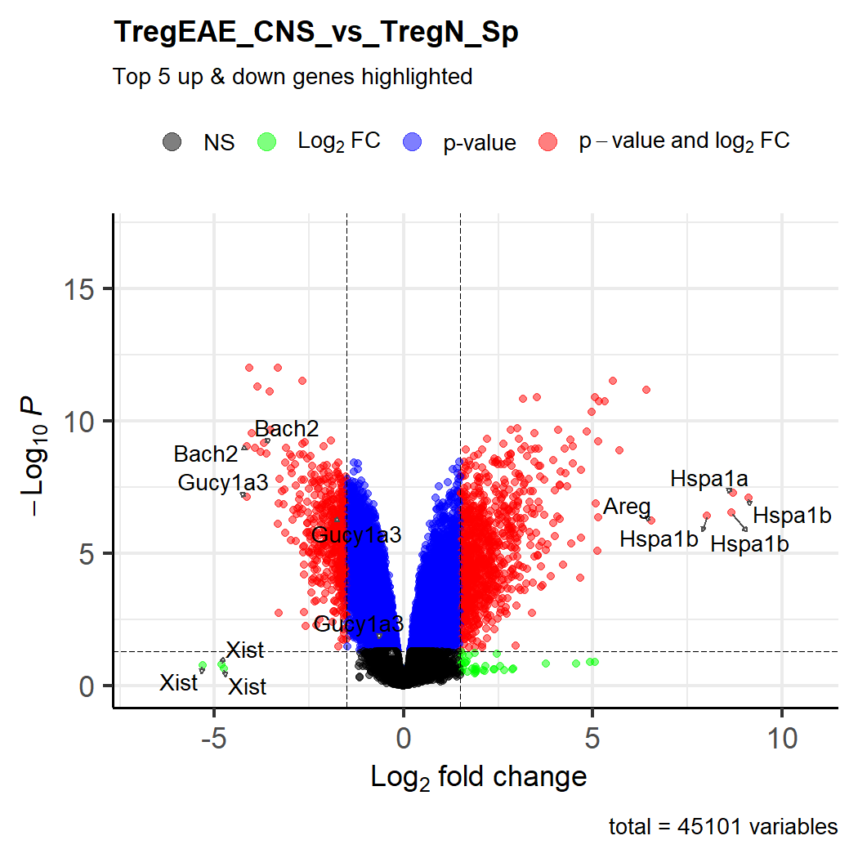

Slide 7
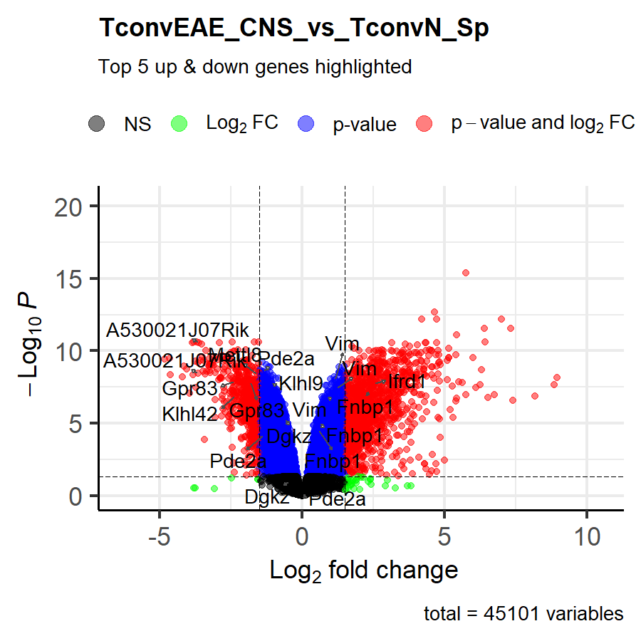

Slide 8
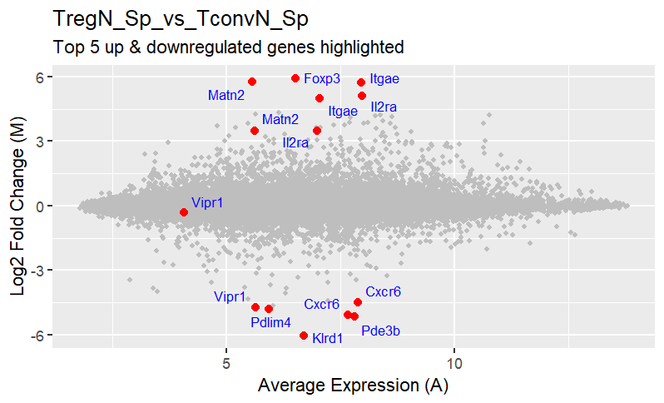
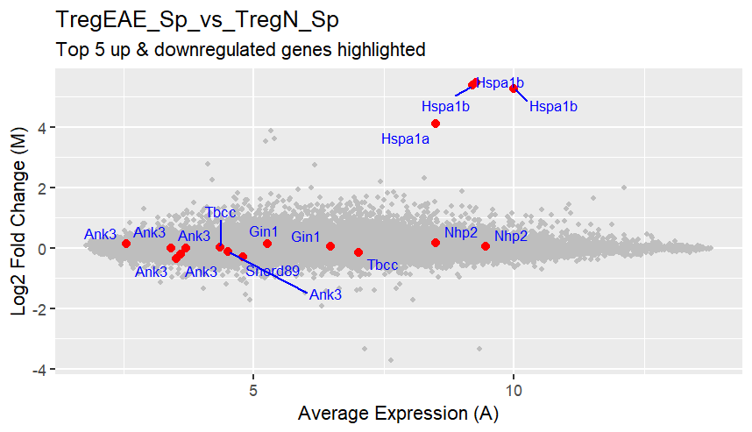
FoxP3:
Primary Treg
transcription factor
Heat shock proteins:
Up during injury and inflammation
IL2ra:
Essential
Component of
Treg differentiation
Pde3b:
Treg Metabolic requirements
Cxcr6:
Chemotaxis/migration
Ankryns:
Cell structural plasticity/motility/migration

Slide 9
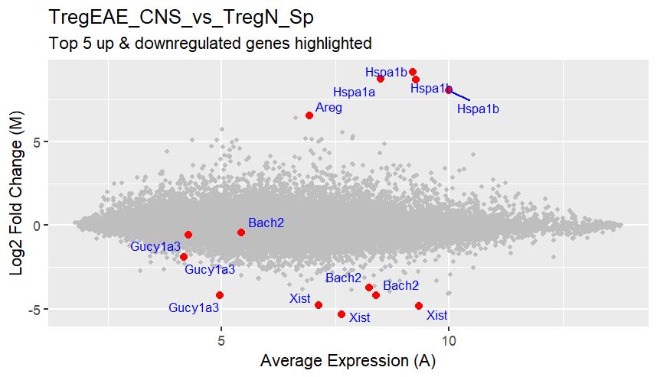
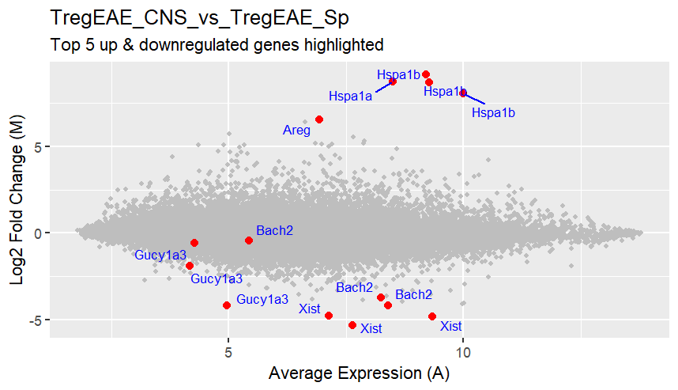
Heat shock proteins:
Up during injury and inflammation
Areg:
growth factor
epithelial and
neurological
tissues
Bach2: Downregulated in peripheral Tregs
Identical top 5 DEGs!
Gucy1a3:
Promotes NO pathway and vasodilation

Slide 10
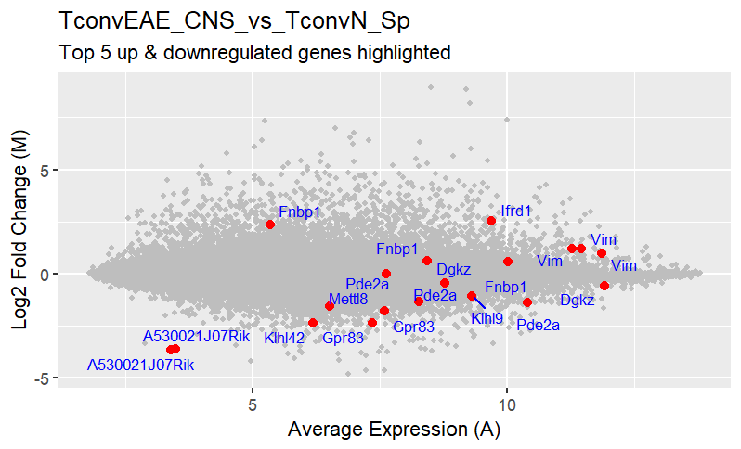
Fnbp1
Ifrd1
A53
Gpr83

Slide 11
Upstream regulator of Interferon I inflammatory response
Promotes cell motility and migration
Upregulated in activated
and downregulated in resting t-cells

Slide 12
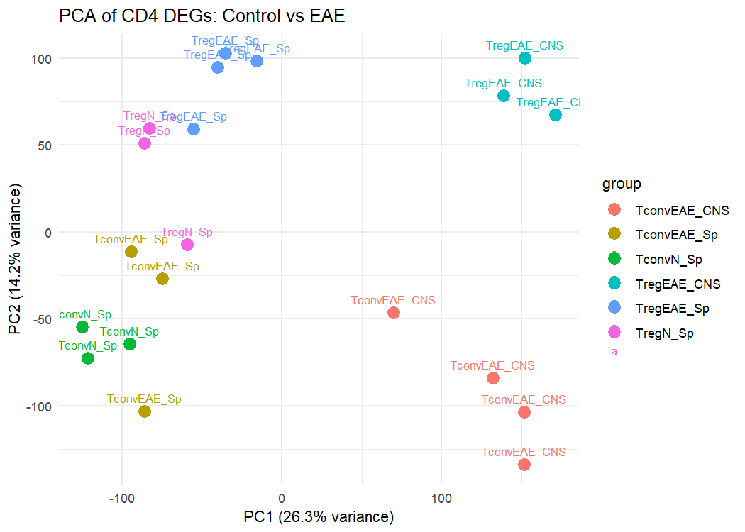
PCA
Of all 45101 genes across 6 T cell phenotypes,
Control and EAE

Slide 13
Tregs

Slide 14
Tregs

Slide 15
Tregs
Tconv

Slide 16
Tregs
Tconv
Spleen
Central Nervous System

Slide 17
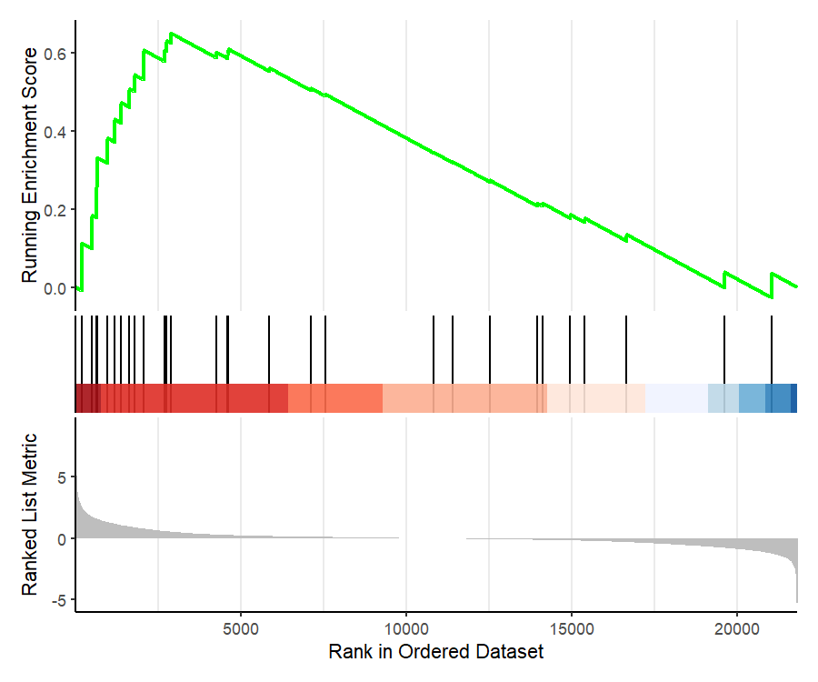
GSEA Murine Inflammatory Pathway
DGE of Tregs from EAE CNS vs Naïve Splenic Tregs

Slide 18
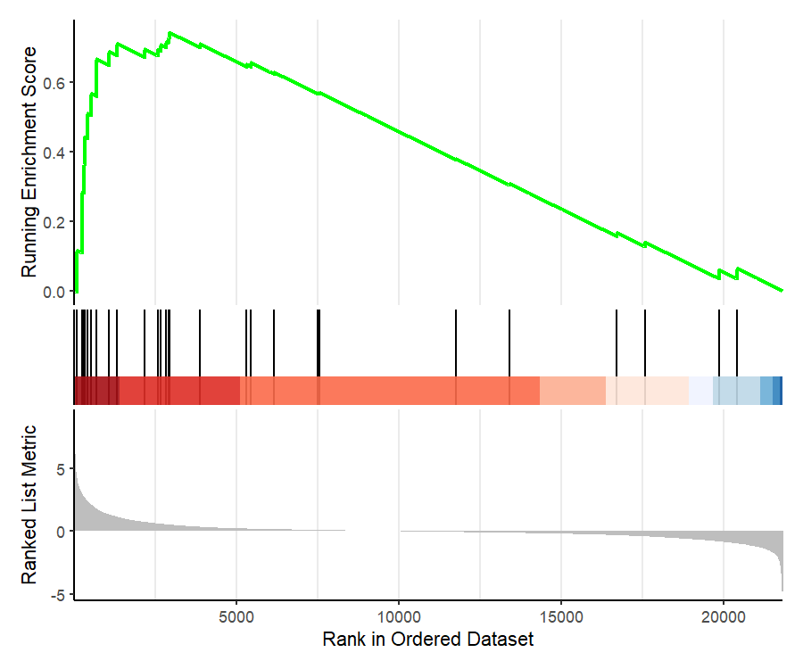
GSEA Murine Inflammatory Pathway
DGE of Tconv from EAE CNS vs Naïve Splenic Tconv

Slide 19
Gene set enrichment analysis (GSEA)
How differential gene expression among observed groups align with canonical functional expression pathway?
Groups used (only 2 contrasts from study)
Tregs: CNS EAE (Disease focal point) vs Spleen (Naïve, Healthy)
vs Murine Inflammatory Response Pathway
Tconv: CNS EAE (Disease focal point) vs Spleen (Naïve, Healthy)
vs Murine Inflammatory Response Pathway
WP_INFLAMMATORY_RESPONSE_PATHWAY
GSEA Molecular signature database

Slide 20
GSEA Murine Inflammatory Pathway
GSEA Murine Inflammatory Pathway
DGE of Tregs from EAE CNS vs Naïve Splenic Tregs
DGE of Tconv from EAE CNS vs Naïve Splenic Tconv
Enrichment Score | Normalized Enrichment Score | P-value adjusted
0.6509818 | 1.750969 | 0.001945999
Enrichment Score | Normalized Enrichment Score | P-value adjusted
0.7439637 | 1.954822 | 0.0001704259
Pro inflammatory pathway more enriched in Tconv

Slide 21
Analysis and summary DEGs Volcano and MA Plot
Treg upregulation of canonical regulatory genes vs Tconv

Slide 22
Analysis and summary DEGs : Volcano and MA Plot
Treg upregulation of canonical regulatory genes vs Tconv
Downregulation of motility and migration genes in splenic Tregs irrespective of inflammation status
Inflammation at disease focal point: CNS Tregs exclusively upregulate epithelial and neurological tissue regeneration factor AREG

Slide 23
Analysis and summary PCA
PC1 appears to indicate Treg Identity
PC2 appears to be CNS
Clustering trends
Q1: Splenic Tregs Naïve and EAE
Q2: CNS EAE Tregs
Q3: Splenic Tconv Naïve and EAE
Q4: CNS EAE Tconv
T-cells that take up residency in spleen and CNS have distinct expression profiles
Greater similarity between T-cell classes than tissue type and disease state.
Clustering hierarchy
1) Class: Treg vs Tconv
2) Tissue residency
3)Disease state

Slide 24
Analysis and Summary: GSEA
Vs canonical inflammatory pathway greater enrichment in Tconv than Tregs at focal point of infection (CNS)

Slide 25
Reference
Pohar, J., O'Connor, R., Manfroi, B., El-Behi, M., Jouneau, L., Boudinot, P., Bunse, M., Uckert, W., Luka, M., Ménager, M., Liblau, R., Anderton, S. M., & Fillatreau, S. (2022). Antigen receptor-engineered Tregs inhibit CNS autoimmunity in cell therapy using nonredundant immune mechanisms in mice. European journal of immunology, 52(8), 1335–1349. https://doi.org/10.1002/eji.202249845

